Slide 1
E-mail

Slide 2
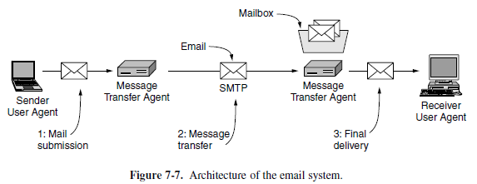
Architecture & Services

Slide 3
Subsystems in Architecture
USER AGENTS
Allows to read and send email
MESSAGE TRANSGER AGENTS
Move the messages from the source to the destination.
Runs in the background on mail server machines
Always available
Automatically moves email through the system from the originator to the recipient with SMTP (Simple Mail Transfer Protocol).

Slide 4
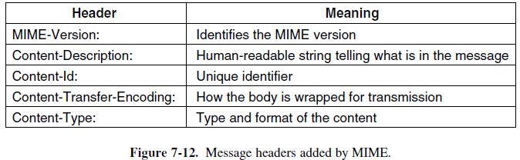
MIME
Multipurpose Internet Mail Extensions

Slide 5
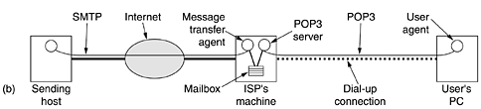
POP 3
Allows a User Agent(Client’s Machine) to contact the ISP’s message transfer agent (Server’s Machine) and allow e-mail to be copied from the ISP to the user when user is online

Slide 6
POP3
POP3 begins when the user starts the mail reader.
The mail reader calls up the ISP (unless there is already a connection) and establishes a TCP connection with the message transfer agent at Port 110.
Once the connection has been established, the POP3 protocol goes through three states in sequence:
Authorization
Transactions
Update

Slide 7
IMAP
Assumes email will remain with server indefinitely and not transferred to the user’s machine
Assumes User will be working online
provides mechanisms for creating, destroying, and manipulating multiple mailboxes on the server
User can ask for a particular email by many other attributes not only arrival no (done in POP3)
Users can see partial messages unlike POP3
Users can even send and receive messages

Slide 8
Web Mail
Available through a web browser.
Requires authentication. Then dynamically created to allow access to one’s mail. The pages are made responsive to client’s mouse click.
In this model, mail submission happens using the normal Web protocols by posting data to a URL.
The Web server takes care of injecting messages into the traditional mail delivery system that we have described.
For security, the standard Web protocols can be used as well. These protocols concern themselves with encrypting Web pages, not whether the content of the Web page is a mail message.
Examples: Google Mail, Microsoft’s Hotmail, Yahoo! Mail

